Slide 1
Drug Overdose Deaths and
Contributing Factors
Morgan Bee, Rowan Clark, Amy Dos Santos, Brian Hester, Kiley Karecki

Slide 2

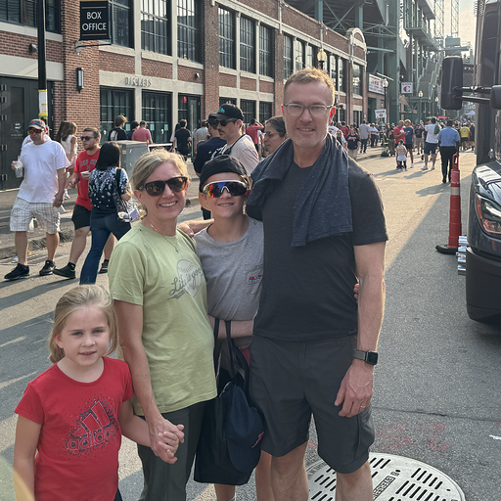



Meet the Team
Rowan Clark
Statistician & Visualization Developer
Brian Hester
Director of Research
Kiley Karecki
Data Analyst
Amy Dos Santos
Project Manager
Morgan Bee
Data Cleaner

Slide 3
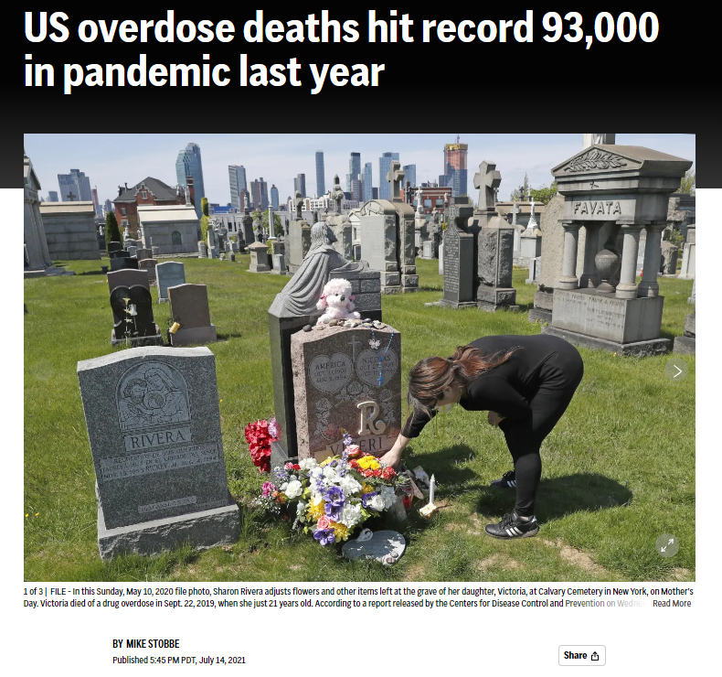
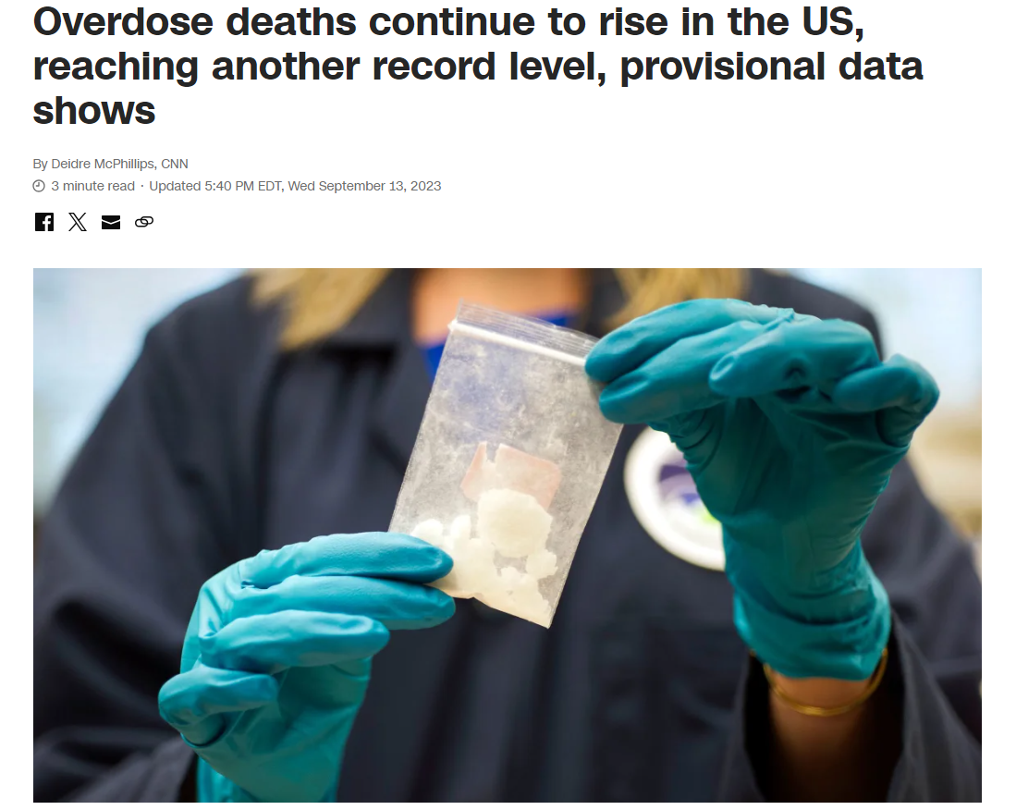

Slide 4
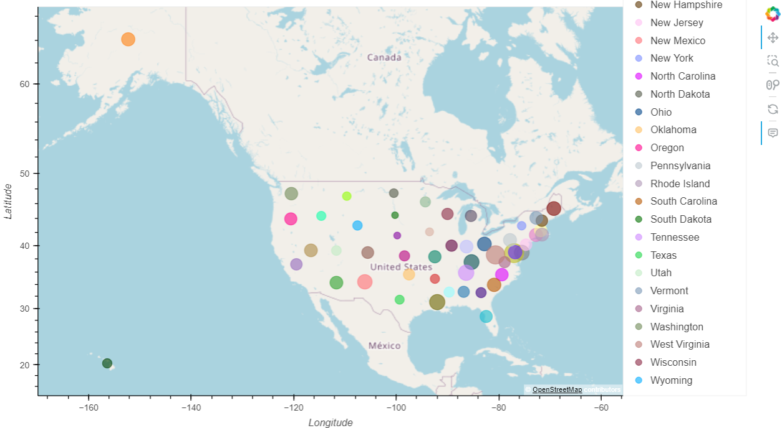
Death by Overdose in the US
Insert map visual with bubbles over each state representing overdose rates

Slide 5
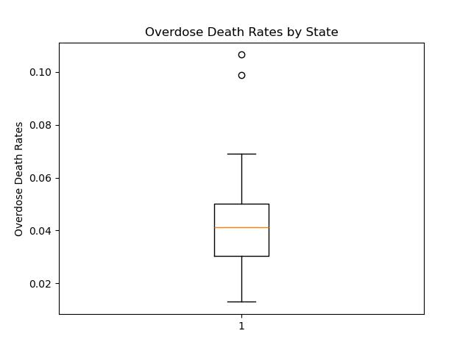
Overdose Rates Summary Statistics
Highest | Washington D.C. (0.1065 OD deaths per capita)
Mean: | Colorado (0.0411 OD deaths per capita)
Lowest | South Dakota (0.0130 OD deaths per capita)

Slide 6
Contributing Factors Investigated
Education
Median Household Income
Unemployment

Slide 7

Education

Slide 8
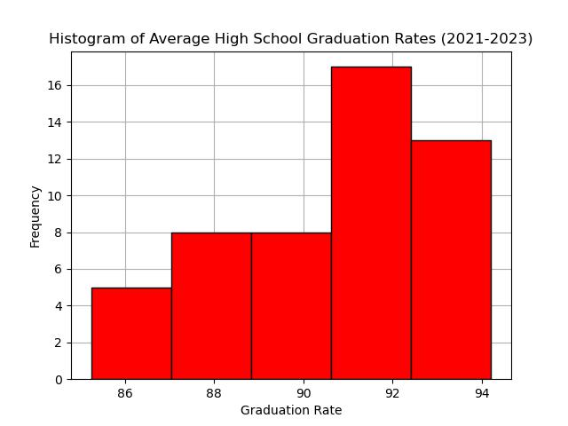
Education bullet points to touch on visualization

Slide 9
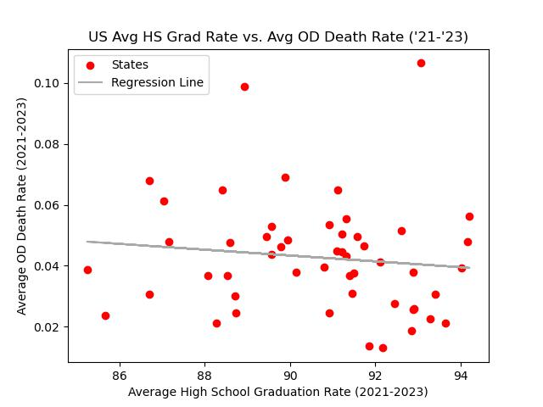
Education and Drug Overdose Rates
r-squared value: -0.117
p-value: 0.412
Notes:
Upon first glance at the relationship between high school graduation rates and drug overdose rate, you can see that although slight, the average death by drug overdose rate does decline as states achieve higher high school graduation rates.
Two outliers that we can see on the graph here are Washington DC, with a drug overdose rate of .1% and a high school graduation rate of 93%. The other is West Virginia, with a drug overdose rate of 0.9% and a high school graduation rate of 88%.
The r-squared value of this regression is -.117, which is quite low. This demonstrates that the two variables are weakly correlated, and that assessing high school graduation rates will not be a sufficient indicator of any given state’s drug overdose rate.
Our null hypothesis for the contributing factor of High School Graduation Rates was that there would be no change in drug overdose rate with a fluctuation in high school graduation rate, and an alternative hypothesis that as high school graduation rates increased, drug overdose rates would decline significantly. However, with a p-value of .412, we must fail to reject the null hypothesis. There is not sufficient evidence to suggest that a decrease in drug overdose rate with an increase of high school graduation rate did not happen by chance.
In the case that we investigated the relationship of education and drug overdoses further, my colleagues and I may want to look into other factors we had not considered before, such as the age that people are more likely to try drugs or become addicted to them. For example, if we had found that college-aged people are more likely to try drugs than other age groups, looking at college graduation or dropout rates may have had a stronger correlation to drug overdose rates. Still, however, there is the possibility that education at any level and drug overdose rates are simply not correlated.

Slide 10

Median Household Income

Slide 11
What do we mean by “Median Household Income”

Slide 12


Slide 13
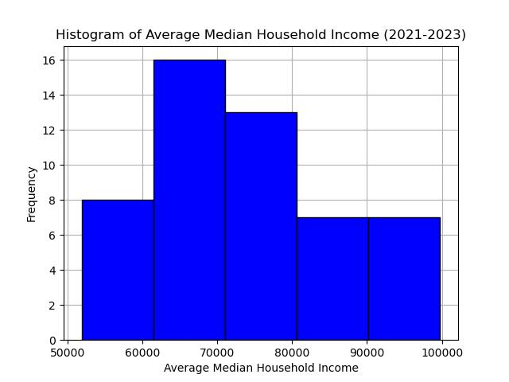
X axis: Average Median Household Income
Y axis: Frequency or number of occurrences for each income range

Slide 14
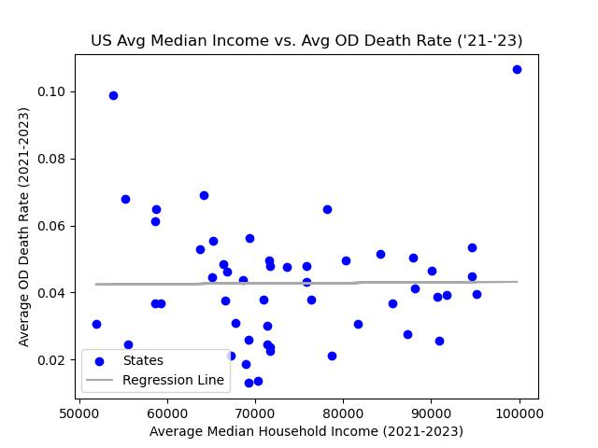
Median Household Income & Overdose Rates
r-value: 0.01
p-value: 0.943
Outliers:
DC $99,775
Puerto Rico $23,990

Slide 15

Unemployment

Slide 16
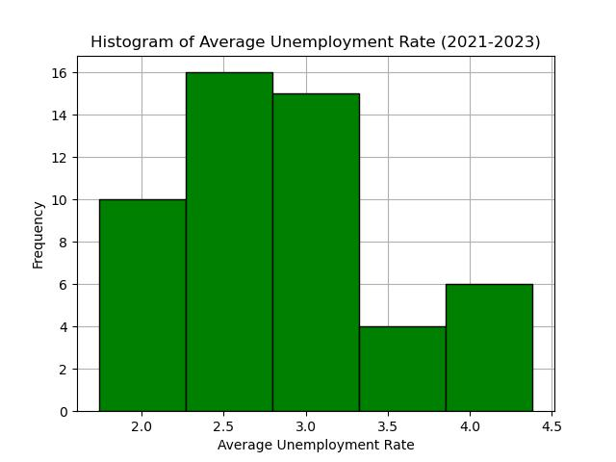
Unemployment bullet points to touch on visualization

Slide 17
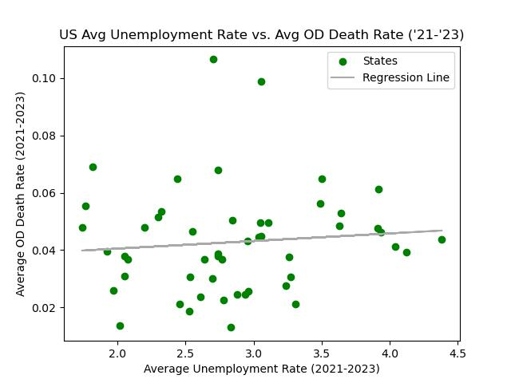
Unemployment and Overdose Rates
Information and conclusion about visual of correlation between unemployment and drug overdose

Slide 18
Conclusions

Slide 19




Conclusions
Rejection of Hypothesis
New Variables being introduced
Next Steps

Slide 20
Drug Overdose Deaths and
Contributing Factors
Morgan Bee, Rowan Clark, Amy Dos Santos, Brian Hester, Kiley Karecki

